Slide 1
Real-time LEO satellite imagery insights with Serval
Bill Tao, Om Chabra, Ishani Janveja, Indranil Gupta, Deepak Vasisht
Notes:
Hi, I’m here to talk about how to generate insights from LEO satellites earth imagery in near real time.

Slide 2
Notes:
If you look at the number of satellites launched, it has experienced an exponential increase in recent years. Most of the newly launched satellites are this type of small satellites that can fit in a person’s hand. They are cheaper to launch, and therefore companies can launch them in large constellations.

Slide 3
Queue!
Notes:
These satellites are smaller but more intelligent, and they can carry all kinds of hardware on board such as photography hardware and computation hardware. Thus they have a new emerging application: taking high quality images of the earth.

Slide 4
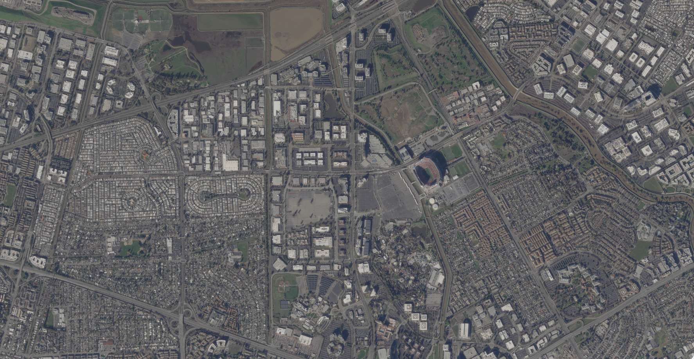
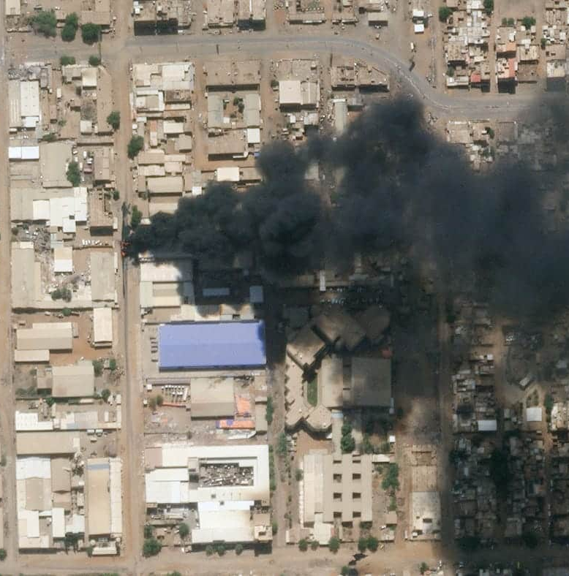
Notes:
In fact, here’s a sample image Santa Clara County taken by a Planet SkySat, and inside this circle is Hyatt Regency Santa Clara, the very place that this conference is happening. Some of these images contain interesting time-sensitive events going on such as a wildfire or a bomb attack.

Slide 5
Send me the images that contains forest fires within California
OK. Wait several hours to days and they will come.
TOO LATE!!!
This Photo by Unknown Author is licensed under CC BY-SA
Notes:
These images are useful for many potential users. For example, CA fire department can query all the forest fire images that Planet has to respond to them. However, this is hard to achieve right now, because the majority of images see a delay of up to several days before they are delivered to the user, and this is definitely an unacceptable length for a fire department. We need a faster and more efficient way of running user queries on interesting images.

Slide 6
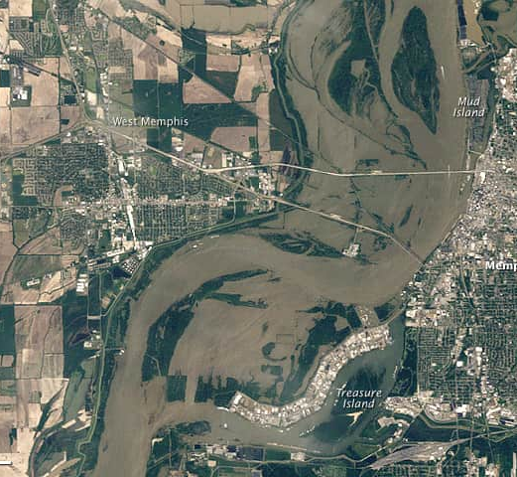
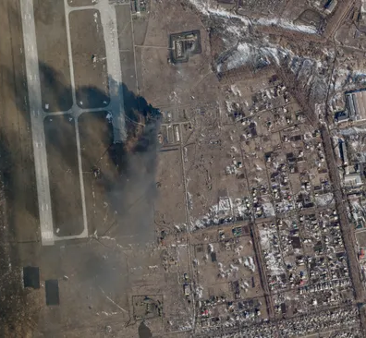
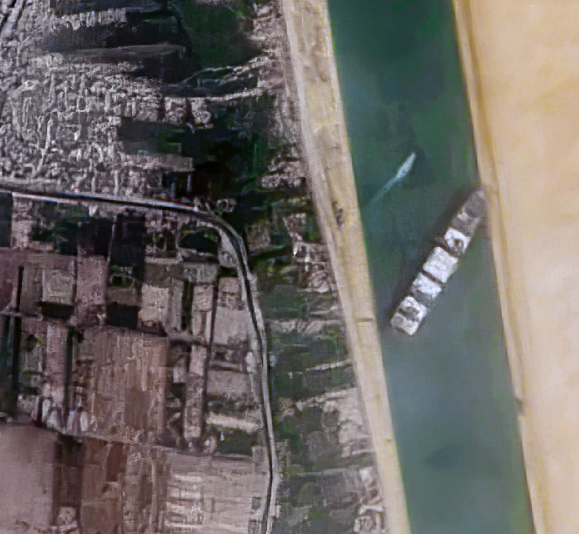
Real-time Earth Monitoring
Need real-time information
But.. takes hours to days
Notes:
In fact, forest fire is not the only scenario where latency is essential: satellite imagery is also useful in other cases such as monitoring flood, detecting military operation and monitoring maritime traffic. Thus, we need near real-time information on these images to be delivered to the interested users.

Slide 7
In this talk: Near Real-time Earth Monitoring
Current approaches and their limitations
Serval: near real-time imagery through query bifurcation
Evaluation: trace-driven simulations on 200 satellite data
Notes:
In the talk today, I am going to talk about why current approaches does not satisfy the requirements for LEO satellite systems, and our new system called Serval that tries to address these challenges, and finally a real-world evaluation of Serval.

Slide 8
Approach 1: processing on ground
. . .
Notes:
The first approach is how the LEO imagery system works today: like any IoT system, we have satellites on the edge of the network in their orbit in space, taking images of the earth. On the ground we have a terrestrial network system containing ground stations and a cloud server to support the LEO constellation. The satellite does not process the queries by the users on the images, but establish connection with the ground station and downlink the image to the ground for processing and delivery to the users.

Slide 9
Problem: intermittent connectivity
Notes:
The problem here is that the satellite does not stand still like most terrestrial networked devices do. Instead, they go at very high speed in a fixed orbit like shown in this animation, while the earth is slowly spinning. If we project its location on the earth surface, it will look like something like this. The problem is a ground station can only cover a small region. Even if companies like Planet have established a global ground station network, it’s still not enough to cover the entire globe, and, as a result, the satellite will get in and out of contact from time to time.

Slide 10
Network delay in LEO satellites
Queue!
Notes:
And because this unique connectivity pattern, what happens is that a satellite will accumulate images in its storage when it’s not in contact with a ground station

Slide 11
Queue!
Notes:
When it gets into contact with a ground station, since sometimes the connection quality is bad or the ground station capacity is low, it cannot send all the images it has cached down, and as a result

Slide 12
Cause large latency for critical images
Queue!
Notes:
Some images have to wait till the next contact with a ground station to be downloaded, increasing the delay that it experiences. But wait… if what our users are interested in is just one out of 4 images here, can’t we just downlink that one image? This would solve the link capacity limit problem.

Slide 13
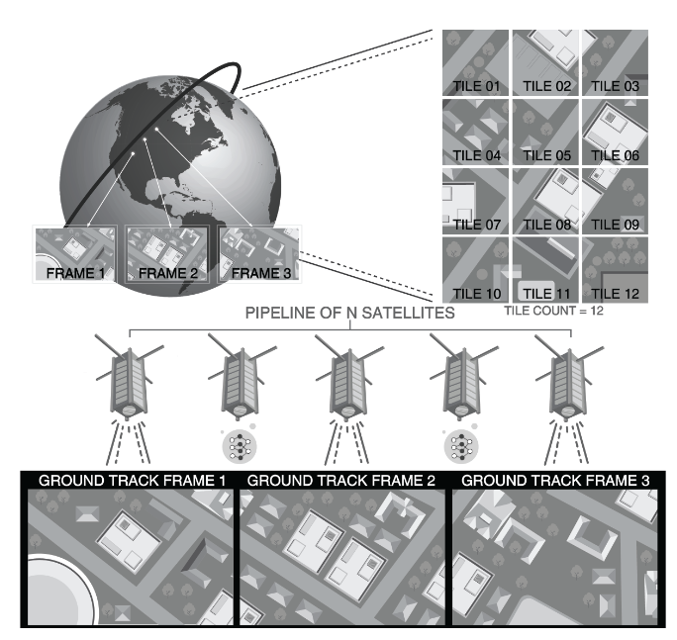
Approach 2: discard images on satellites
[1] Orbital edge computing, ASPLOS 2020
[2] Kodan, ASPLOS 2023
Notes:
To address this network bottleneck, a line of previous works including OEC and Kodan from ASPLOS proposed this new approach that uses edge computing on satellites to process the user queries on the edge and only send down the user required information which reduces the network congestion

Slide 14
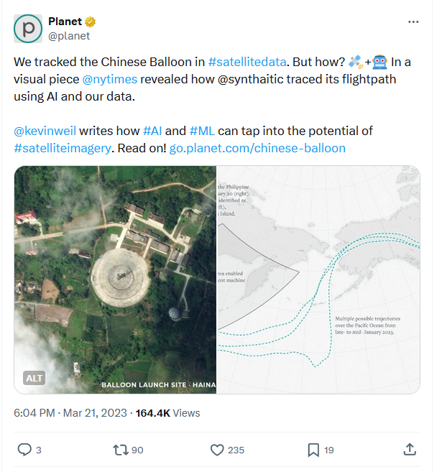
Cannot handle emerging applications
Queue!
Notes:
So let’s take a step back, filter out that one image that has forest fire and downlink it, this should solve the latency problem. However, the problem is that you never know if an image that is not interesting now will become interesting sometime in the future. Take this event here as an example. We know that a Chinese balloon entered US air space in 2023. The Planet company was able to backtrack the trace of the balloon, by looking back in time into those images containing the balloon, that was not found interesting at the time it was taken. This would never have been achieved if those images were discarded. So, this option of filtering and discarding images clearly has its drawbacks. So, we need a new way of handling the images on satellites.

Slide 15
Limited compute vs. excessive image
Compute on board
Photography on board
Limited size/weight
Limited power
Cannot support a multi-GPU server onboard
1 image every 2 seconds
Hi-resolution: 8000x10000
2TB of data a day
Cannot scale to multiple applications
Notes:
There is also another challenge that OEC faces: the compute onboard the satellite is very limited. The compute is limited by size and weight because it’s onboard a satellite. It is limited in power because it’s not plugged in a power grid but relies on solar panels to harvest energy to run. Because of this, a satellite cannot support a multi-GPU server that people normally use to run deep learning models. On the other hand, the camera on the satellite takes 1 image every 2 seconds when it’s operating, and each image is a huge image containing tens of millions of pixels covering hundreds of sqkms. In fact, one satellite in the Planet constellation can generate up to 2TB of data per day. The satellites are generating way too many images for them to process, and Serval needs to identify the important images with very limited compute.

Slide 16
Challenges with status quo
Approach | Low latency? | Emerging queries? | Scalable?
Processing on ground | ❌ | ✔ | ✔
Filter & discard | ✔ | ❌ | ❌
??? | ✔ | ✔ | ✔
Notes:
So to summarize, the traditional approach which is processing everything on ground suffers from long latency but has all the data down and does not require any compute on satellites. OEC on the other hand, significantly reduces latency but cannot handle emerging new queries and cannot scale up to numerous queries running in parallel into the system. The question is : can we get the best of both world?

Slide 17
In this talk: near real-time earth monitoring
Current approaches and their limitations
Serval: near real-time imagery through query bifurcation
Evaluation: trace-driven simulations on 200 satellite data
Notes:
Today, we present our new system Serval, that tries to achieve the best of both worlds by employing new techniques in handling edge computation on satellites.

Slide 18
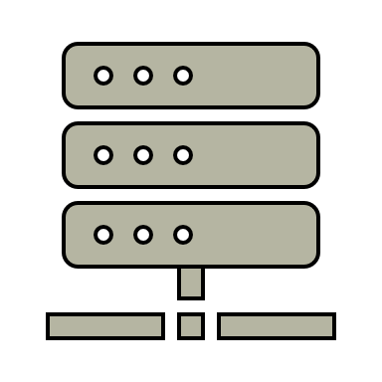
Solution 1: prioritize important images on satellites
. . .
Notes:
First, to be able to handle emerging applications that might require historical data, Serval is built on a different idea: to prioritize images instead of filtering and discarding them on the edge.

Slide 19
Solution 1: prioritize important images on satellites
. . .
Notes:
The idea behind Serval is to utilize the computation on board the satellites to run user queries on the images, and prioritize transmitting the interesting images, while not discarding any images that might be “not interesting”.

Slide 20
Solution 2: exploit satellite predictability
Idea: Exploit this information to offload computation to the ground
Know satellite’s location in advance
Know historical data from the same location
Notes:
Moreover, Serval uses the predictability of the satellite movement. Because satellites move in fixed orbits, we know where they will be in the future, and we know which part of the earth they will take photos from in the future, and we already have photos from the past over the same place on the ground. This gives us the idea of using this information to offload some compute to the ground.

Slide 21
Solution 2: exploit satellite predictability
For image in cache:
---> location(image) in CA
---> forest(image) == True
---> cloud(image) == False
---> fire(image) == True
Find all the forest fires in California
Notes:
We first look at how a user query is modeled: suppose you ask your computer to “find all the forest fires in California”, how will your computer process this request? The query will essentially be converted into the intersection of four conditions: the image being in CA, the image having forest, the image being not cloudy and the image containing fire.

Slide 22
Serval: query bifurcation
California
Forest
Cloud
Fire Detector
California Forest Fires
Notes:
We can see that in this way, a query about CA forest fires is actually a combination of four filters: California, forest, fire and cloud. Serval developed the technique of “query bifurcation” to reduce the compute load.

Slide 23
Serval: query bifurcation
California
Forest
Cloud
Fire Detector
Port
Cloud
Vessel Counter
“Glacial”
“Dynamic”
Notes:
Serval bifurcates this chain of filters into two categories: on the left side we have “glacial” filters, whose feature does not change rapidly with time. i.e. A place belonging to CA last month is probably still in CA today and same for forest. On the right side we have dynamic filters whose feature do change rapidly with time like cloud and fire. We realize that this bifurcation doesn’t only apply to this one application. Take this other one for example: trading companies are interested in analyzing the number of vessels near a hub to predict oil price and do trading. This application can be modeled as 3 filters: port, cloud and vessel detector, and it can again be bifurcated.

Slide 24
Serval: query bifurcation
California
Forest
Cloud
Fire Detector
Port
Cloud
Vessel Counter
Notes:
Therefore, the entire compute load is bifurcated.

Slide 25
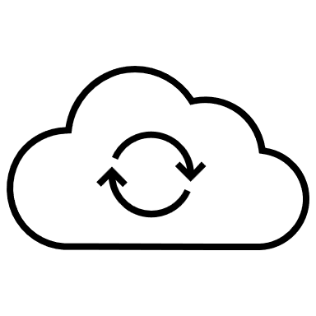
Serval: distribute compute
California
Forest
Cloud
Fire Detector
Port
Cloud
Vessel Counter
Old image
New image
100%
0.2%
Notes:
And using the predictability of satellite trajectories, we can compute the glacial filters just on the ground on the old images over the predicted regions because we are able to predict from where the new images will come, and only compute the dynamic filters using new images taken by the satellite on the satellite, thus saving limited compute resources. In fact, from our evaluation later, we were able to reduce over 99% of the computation load on satellites using this method.
Moreover, we realized that the predictability is not just about historical images: other information can be predicted too, for example, weather information.

Slide 26
Serval: use external information
California
Forest
Cloud
Fire Detector
Port
Cloud
Vessel Counter
Old image
New image
Notes:
We know that cloud filter is a common component for a lot of applications because it’s important to make sure that an image is not just pure cloud and actually contains information about the earth surface. In such case, when the weather report gives a high fidelity on the cloudiness of a certain region, we can just bypass the cloud detection step on the satellite and just use the weather information, thus saving more compute resources.

Slide 27
Serval: system design
Applications
Prior Location Information
Weather
Cloud Detection
California
Forest Fire Detection
Forest
Vessel Detection
Ports
Complete Digest
Client-facing apps
Images & Insights
Images
Notes:
With all the principles in mind, the Serval system is designed as follows: it consists of cloud, ground stations and satellites. The ground station will gather information such as weather report, and also compute the location of the satellite and the glacial filter results of the locations using old images. It will then send the information to the satellite, which will run the rest dynamic filters on the new images and send the interesting information down in high priority. The ground station will assemble the information and send it to the cloud where it will be made available to the users.

Slide 28
In this talk: Near Real-time Earth Monitoring
Current approaches and their limitations
Serval: near real-time imagery through query bifurcation
Evaluation: trace-driven simulations on 200 satellite data
Notes:
In the talk today, I am presenting Serval, a new system we built that tries to solve this long delay and deliver urgent satellite imagery in near real-time. I’m going to talk about the challenges that the current systems face, how Serval addresses these challenges and finally a real-world evaluation of Serval.

Slide 29
Evaluation: satellite images
Real image collected by the entire Planet Dove constellation:
Over 10,000,000 images taken over 20 days
We downloaded the 40,000 in CA that’s over 13TB, and the metadata of the rest
Notes:
We evaluated Serval based on simulation using real-world traces based on the Planet Dove constellation. The constellation collected over 10M images over the 20 days of our experiment, and we downloaded the image content of 40000 of them over CA to run computer vision models through them.

Slide 30
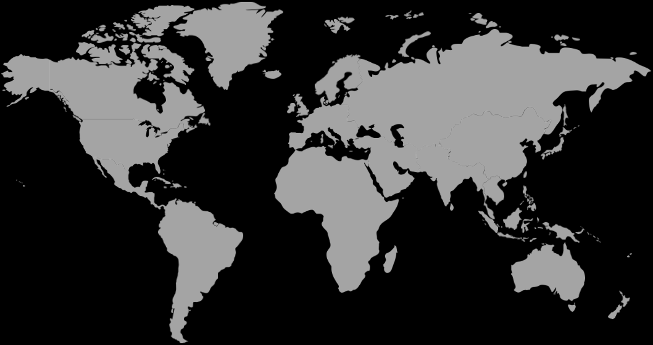
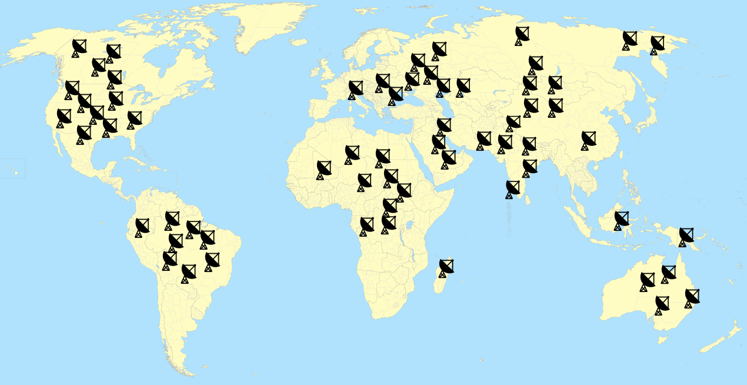
Evaluation: testbed
Ground station coordinates: Planet ground station; L2D2 (SIGCOMM 20)
Applications: CA wildfire detection & port vessel counting
Trace-driven “hardware-in-the-loop” simulation
Notes:
As for ground stations, we used 2 configurations: a distributed ground station system proposed by paper “L2D2” from SIGCOMM 20 and the current ground station network of Planet whose coordinates were estimated based on publications by Planet. We chose CA wildfire detection and port vessel detection as sample application, and we did a trace-driven simulation using a simulator that we wrote.

Slide 31
Evaluation: end-to-end latency
77h (3 day)
~1h
2 minutes
Serval + L2D2
Notes:
We first take a look at the end-to-end performance of image delivery latency. In the baseline case where no prioritization was performed, the median latency is 77 hours or 3 days. When we apply Serval to the system, the latency dropped to 1h. Note that this is just the median latency of the interesting images. When we apply both Serval and the distributed ground station in L2D2, we can further reduce the median latency to 2 minutes.

Slide 32
Evaluation: scale up
Notes:
We also looked at how well serval is able to scale up, as we envision that more and more user queries will be submitted to a LEO constellation that takes photos all over the globe. To stress test Serval, we increased the compute load in the simulation by 2x, 10sx and 20x and measured the end-to-end latency. We can see that even with 20x more load, Serval can still greatly improve the image delivery latency.

Slide 33
What’s next
Compress queries
Notes:
Another thing is that since filters like cloud filter is used by multiple queries, and some other applications can share other same filters, such as California forest fire and deforestation in Brazil sharing forest, we can see that there might be redundancy in the computation load when multiple queries are submitted to Serval.

Slide 34
What’s next
Compress queries
Notes:
Can we reuse filters and compress the compute load when given numerous queries to run?

Slide 35
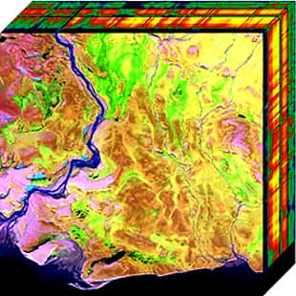
What’s next
Compress queries
Hyperspectral imagery
Notes:
Also, recently LEO satellites are able to take more advanced imagery called hyperspectral imagery. These images consists of a large number of channels that forms a continuous spectrum across certain wavelength. They are 10X larger than rgb images, and the vision models on those images are also much heavier. What can be done in this scenario? These are all open questions that need to be addressed in the future.

Slide 36
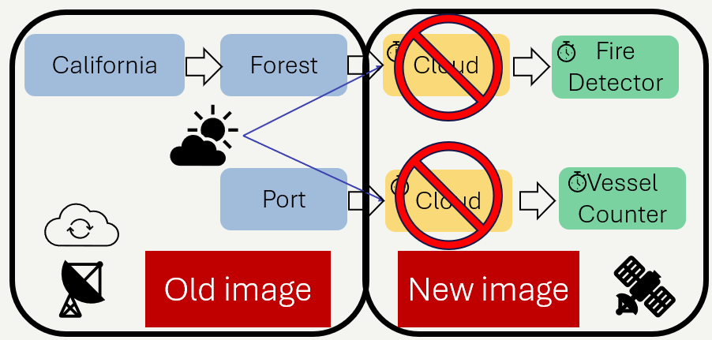
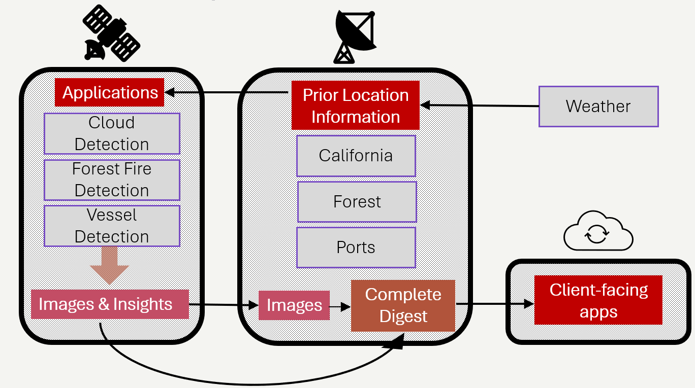
Serval: Near real-time insights from Earth imagery
Notes:
In conclusion, we designed Serval, a new system that is able to deliver insights on satellite imagery in near real time. The core idea behind Serval is to do query bifurcation and use external information as much as possible to reduce compute load and ensure it meets the constraints. Our code is open source and available here.

